Slide 1

Robotic Companion for Long Term Isolation Space Missions
Simon Engler* Jean Hunter, Kim Binsted, Henry Leung
University of Hawaii, USA, Cornell University, USA, University of Calgary, Canada

Slide 2
Long Term Isolation
Space travel mentally and physically challenging (very high stress – long term)
Isolation and social challenges within isolated crew cause performance issues (ISS, HI-SEAS)
Goal is to provide tools to mitigate these issues

Slide 3
Therapeutic Robots
Robots have been developed for therapeutic use.
Robot companions have since been used on the ISS (JAXA
Have minor emotional connections, but unable to engage long term. Lack dependency upon user to create care-taker instincts we have with real pets

Slide 4
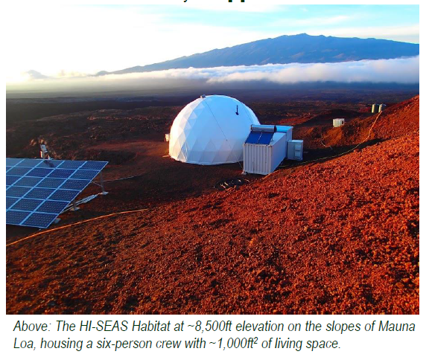
HI-SEAS Mars Analog
Hawaii Space Exploration Analog and Simulation (HI-SEAS)

Slide 5
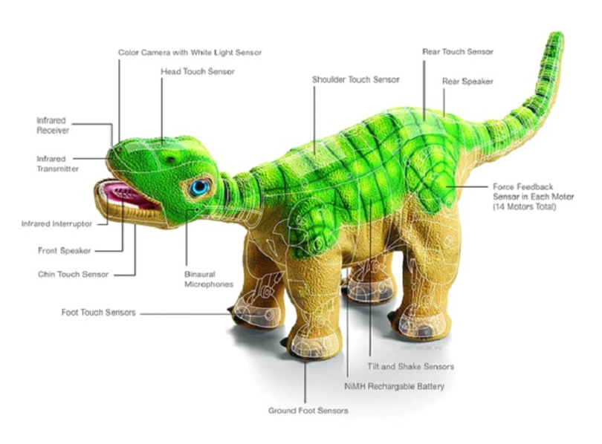
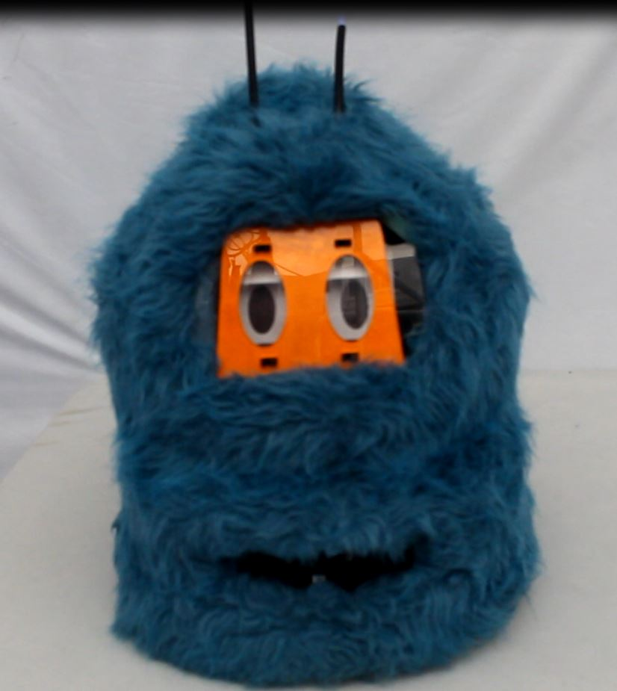
Robot Companions
ROMIBO
PLEO

Slide 6
Passive vs. Aggressive Personalities
PASSIVE
Pleo makes quiet sounds and movements that it wanted to be touched/Feeding and was stationary
Romibo passively blink and change antenna colors. Purr after being petted or scratched. Fall asleep and snore for period of time.
AGGRESSIVE
Pleo walked around habitat. Yowled to get a attention/feeding. Would make sounds when detecting movement
Romibo would constantly try to keep engaged with user. Requesting hugs verbally. Dance when it it felt ignored. Purred upon scratching. Slept for shorter periods of time.
Notes:
Pleo’s passive personality came in the form of a low interaction level and passive calls for
attention. Pleo would make a variety of sounds to indicate that it wanted to be petted, that it
wanted to play, or that it was hungry. It would respond positively to being touched and scratched
by lifting the area being scratched and vocalizing sounds. If the robot was hungry, it would
indicate this by loud vocal calls. A leaf with an RFID chip on it would be held by the crew member
and “fed” to Po. Afterwards, Pleo would ask for petting by lifting its head, calling out vocally, and
wagging its tail. Pleo would also play a game of ‘tugof
–war’ by biting on a RFID stone on a string
and pulling, similar to games domestic dogs play with their owners.
Pleo was also programmed with a more aggressive personality, where the level of interaction was
increased. The crew member was given a number of food items to feed to Pleo that changed its
behavior by making the robot mimic being sleepy or hyperactive. Pleo was allowed to walk around
on the habitat floor during this time, and was capable of locating activity through its cameras and
microphones.
Romibo platform, the passive personality had the wheels turned off and a cushion placed
under the bottom of the robot. This made the robot platform more receptive to being held or
hugged by crew members. The Romibo passive personality was modeled after domestic cats. Crew
members were asked to place Romibo next to them while working on their computers, relaxing and
watching a movie, or while reading in bed. This robotic companion was programmed with a
number of functions to allow it to interact with crew members. For example, Romibo would request
a hug by asking for it verbally (Romibo can speak a few words of English), or blink and change its
antenna colors randomly. When petted, Romibo would giggle, fall asleep, and snore for two
minutes, or hum a quiet tune. The distance and light sensors were programmed to watch for
changes created when a person moved in its vicinity or away. If Romibo sensed movement of
shadows, it would assume a person was moving around and it would call out to the person,
verbalizing ”over here” or ”give me a hug,” in an attempt to encourage crew members to interact
with it.
Romibo was also programmed with an attention demanding personality. The wheels of the robot
were exposed, and Romibo was able to move around on its own. It would call out for attention if it
was left alone for more than five minutes. Also, it was able to move around and detect centers of
activity through sound and movement. In this manner, Romibo is constantly trying to stay
engaged with the crew members. In addition to this, Romibo was programmed to play games,
including following a flashlight and a version of tag, where Romibo would drive away from crew
member for a short period of time and then stop. When the crew member approached the robot it
would be indicated by the distance sensor, and the robot would move away again to make its
escape.

Slide 7
Experimental Design
PANAS – Positive and Negative Affect Schedule
Questionnaire that consists of two 10-item scales to measure words with both POSITIVE and NEGATIVE AFFECT
Clinical and non-clinical studies have found the PANAS to be a reliable and valid instrument in the assessment of positive and negative affect

Slide 8
PANAS Questions
How much did you enjoy using the robot companion today?
PLEO requires feeding during the day. How many times did you feed him?
Romibo is receptive to physical attention. Did you give the robot attention?
Do you consider the well-being of the robot to be important to you?

Slide 9
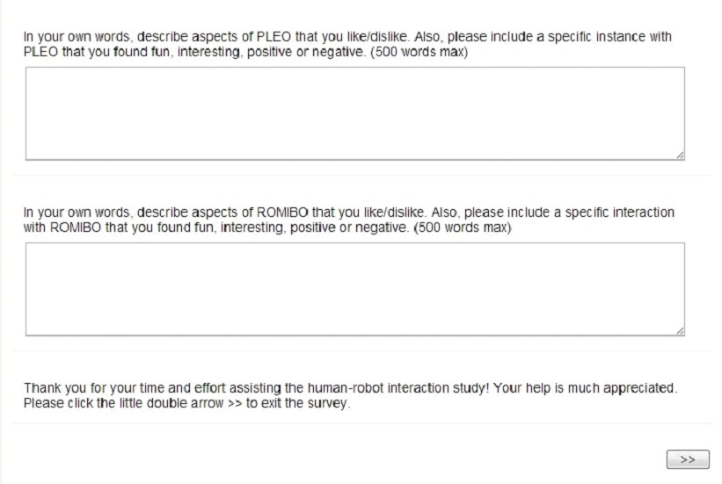
Long Form Questions

Slide 10
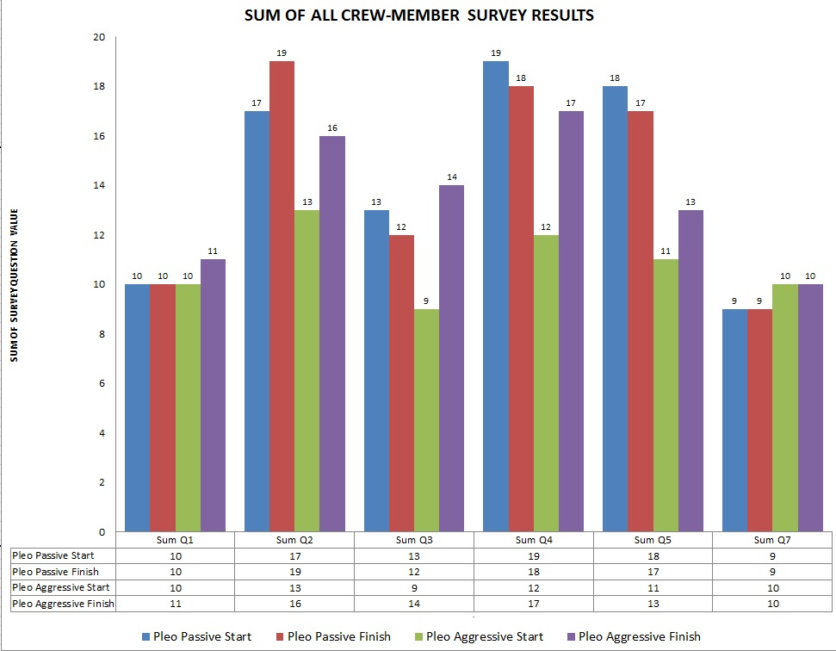
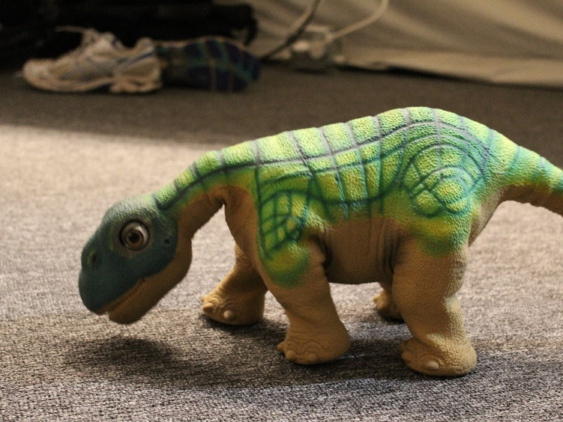
Pleo Results
Notes:
Passive Pleo showed a slight decrease in usage, whereas aggressive Pleo showed a clear increase in usage
Passive Pleo resulted in a very slight drop in crew enjoyment, from 19 to 18. Aggressive Pleo resulted in an overall increase in crew enjoyment, from 12 to 17
passive Pleo experienced a slight drop in the score for feeding, from 18 to 17. Aggressive Pleo saw a slight increase, 11 to 13.
Passive Pleo showed no change over the trial, scoring 9 overall. Aggressive Pleo also saw no change for this question, scoring 10 at the start and end of the trial

Slide 11
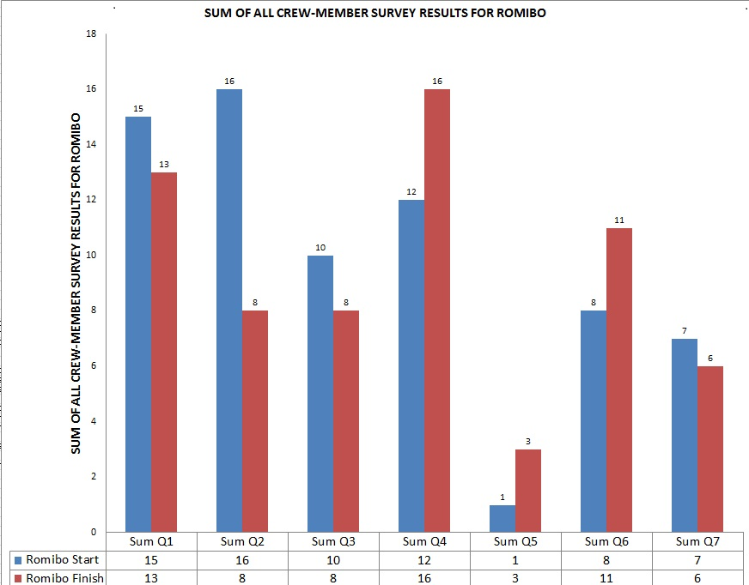
Romibo Results
Notes:
Romibo also resulted in increased crew enjoyment, from 12 to 16.
Romibo saw an increase in physical attention from crew members, going from a score of 8 up to 11.
wellbeing of the robot companion was important to them Romibos? score dropped slightly during the trial, from 7 to 6.

Slide 12
Conclusions
Robotic companions do possess the potential to have a positive emotional effect on a crew member.
Aggressive personality increase interaction but decrease concern for well being.
Passive personalities are more likeable, but cannot maintain long term attachment.
Adults are simply not easily entertained and require a wide range of behavior.
Thus, our goal to continue developing robotic companions with increased complexity

